Slide 1
Online Shopping Mall
Group B1
P2010411 Grant Jing
P2010556 Polo Liu
P2010562 Veronica Chen

Slide 2
Outline
} Business Model
Seller Center
Customer Q&A
Sidebar Shopping Cart
Shopping Festival
Coupons
}
User-friendly Design
}
Marketing

Slide 3
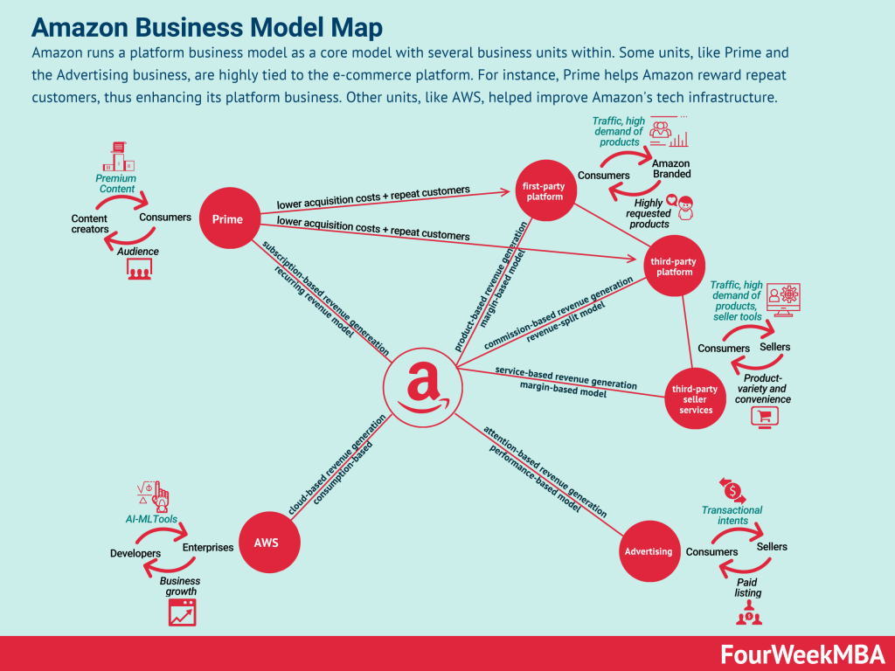
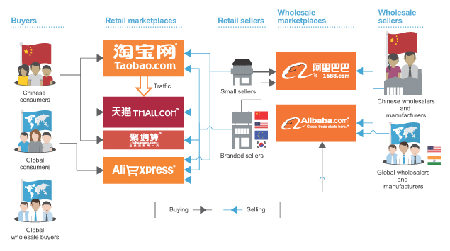
Business Model (Introduction)
Alibaba Business Model
B2C (Business to Customer)
+
C2C (Customer to Customer)
↓
Hybrid

Slide 4
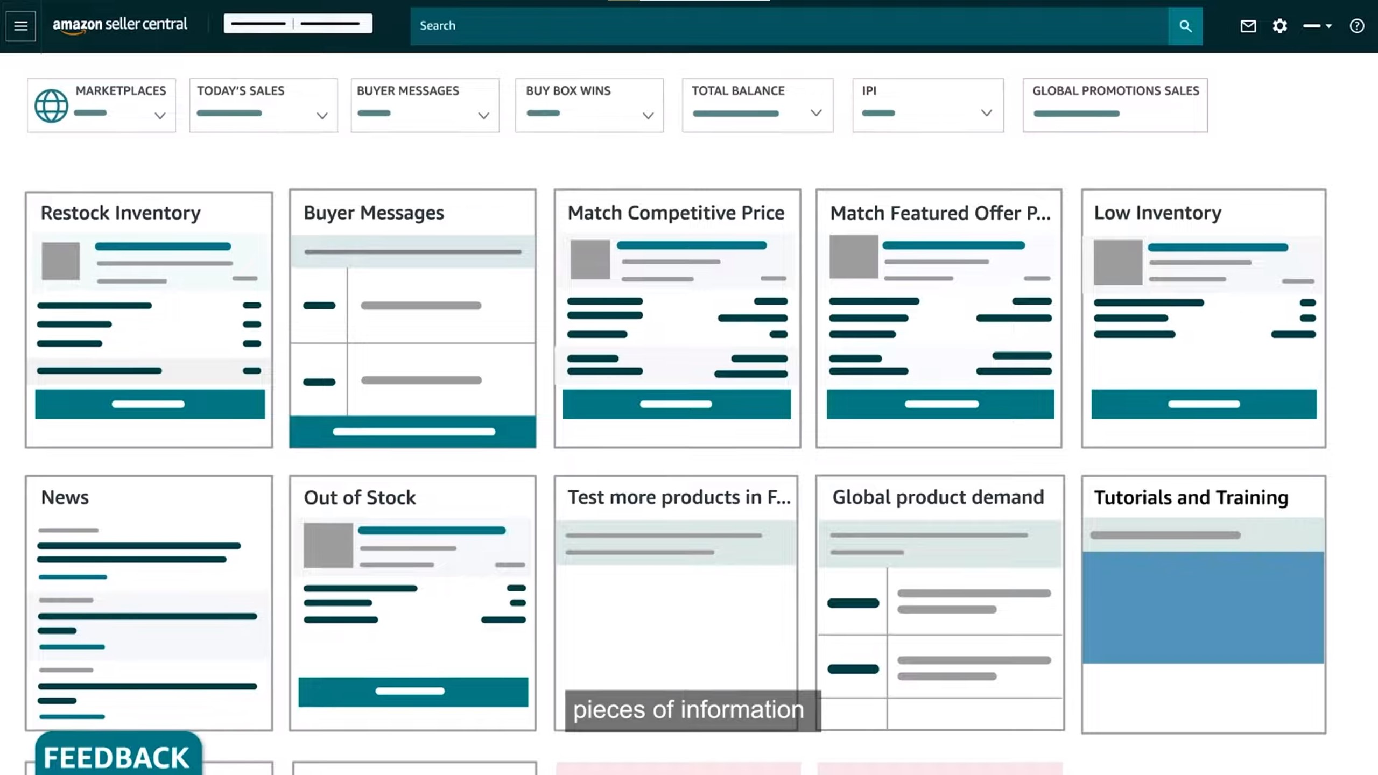
Business Model (Seller Center)
Provide a user-friendly interface especially for sellers in C2C business model
The Seller Center of Amazon

Slide 5


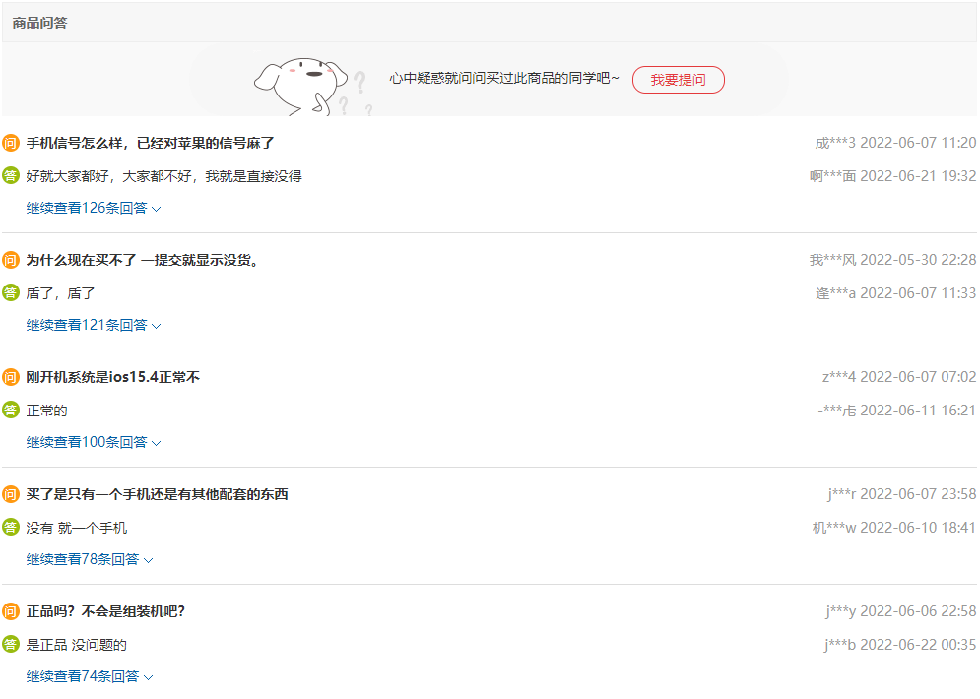
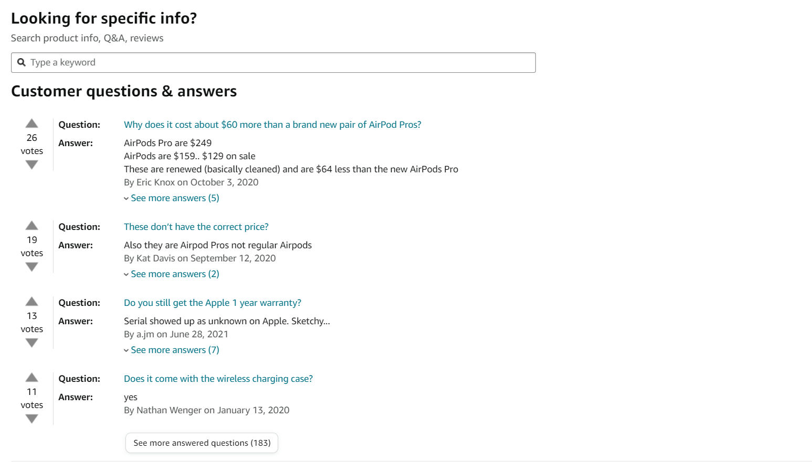
User-friendly Design (Customer Q&A)

Slide 6
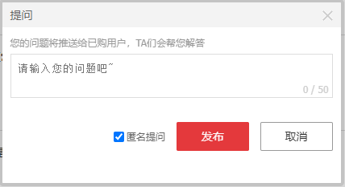
User-friendly Design (Customer Q&A)
The Customer Q&A of JD.com

Slide 7
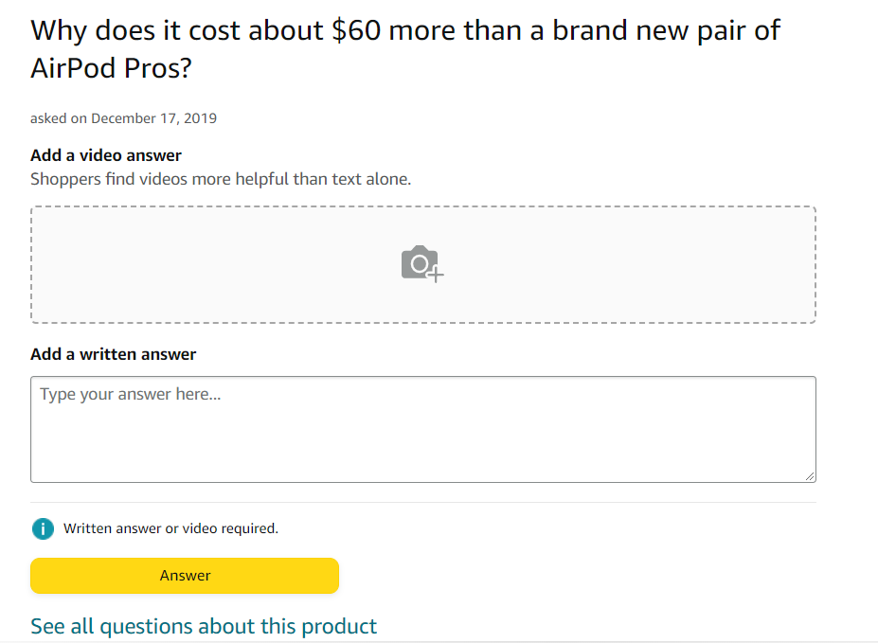
User-friendly Design (Customer Q&A)
The Customer Q&A of Amazon

Slide 8



User-friendly Design (Sidebar Shopping Cart)

Slide 9
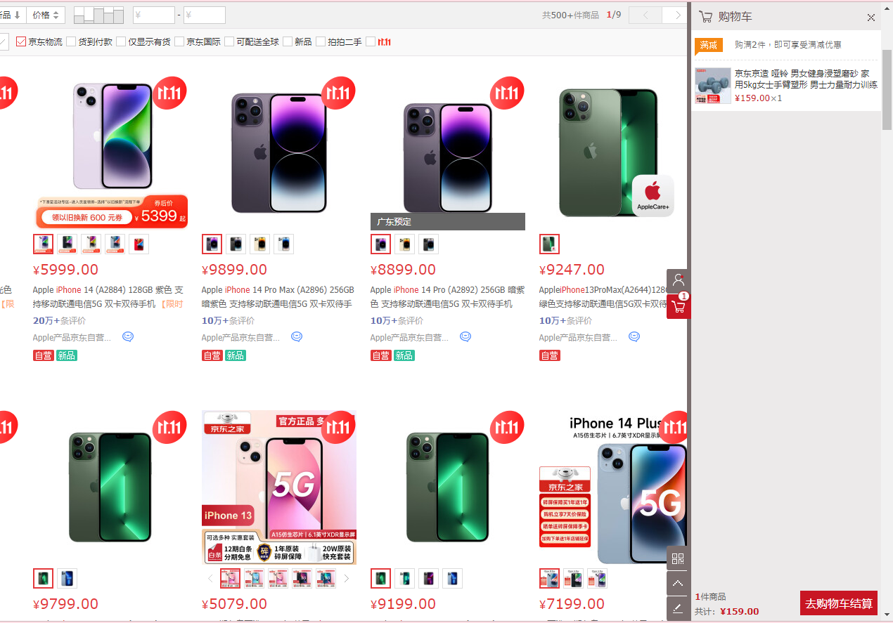
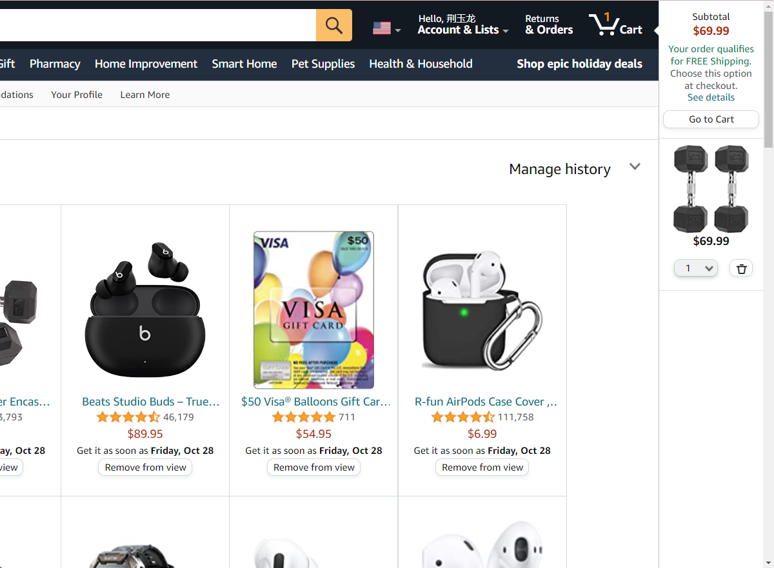
User-friendly Design (Sidebar Shopping Cart)
The sidebar shopping cart of JD.com
The sidebar shopping cart of Amazon

Slide 10
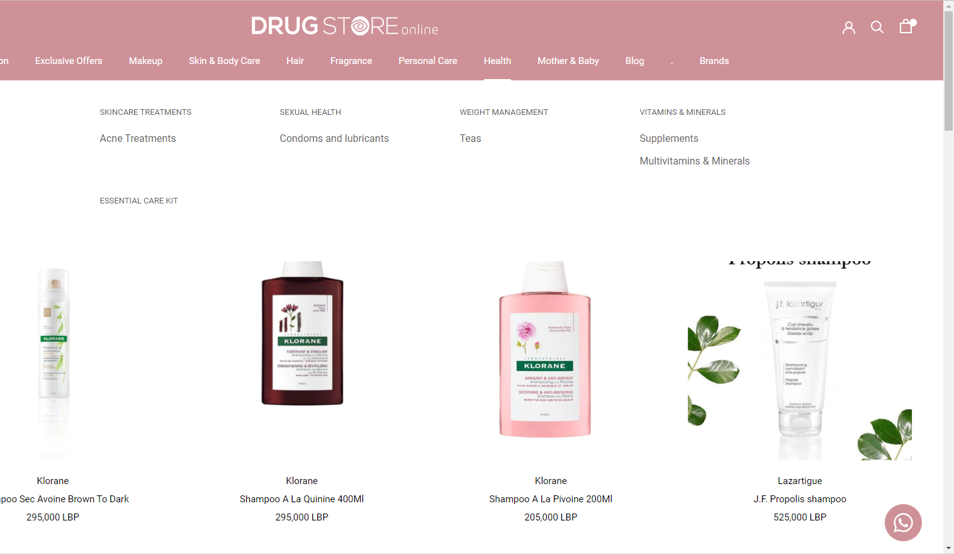
User-friendly Design (Sidebar Shopping Cart)
This drug website doesn't have the sidebar shopping cart.

Slide 11


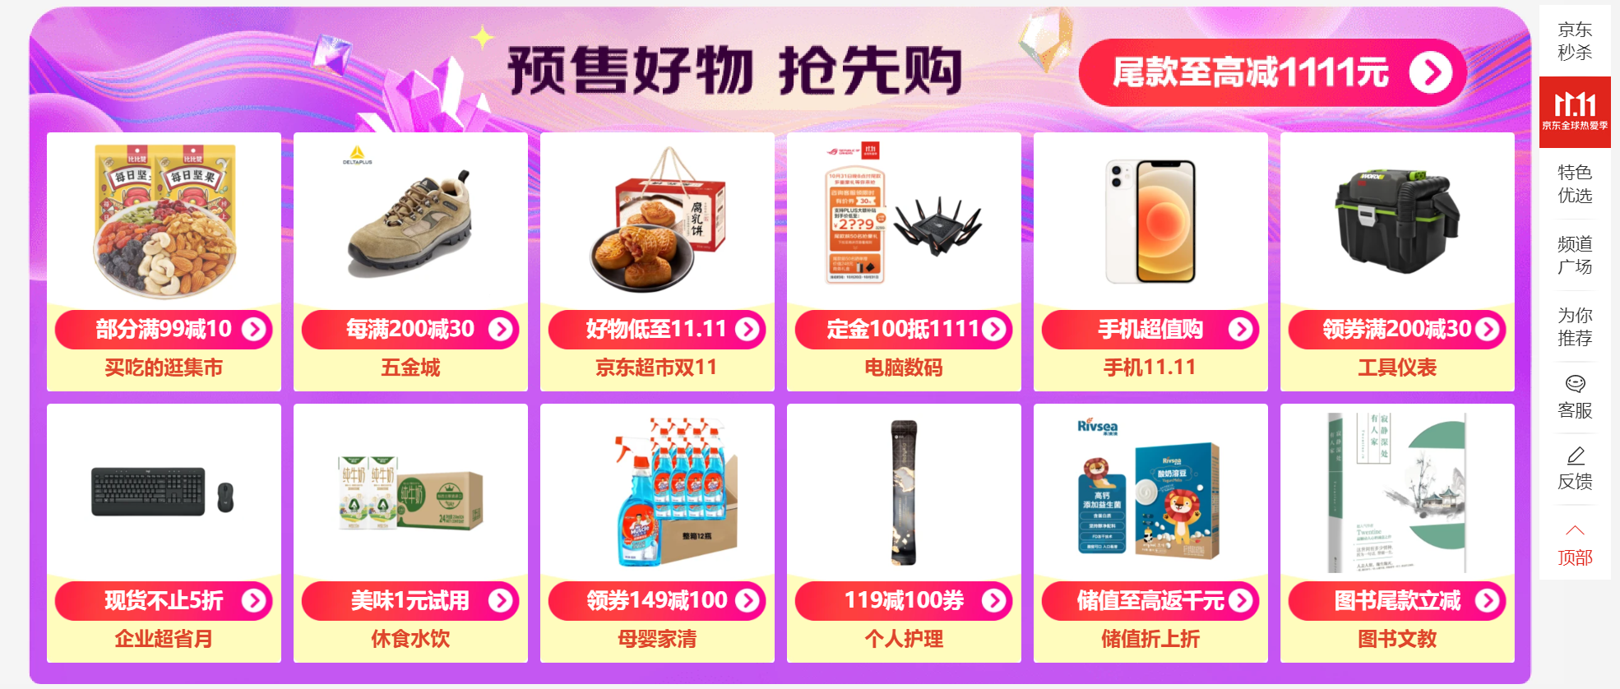
Marketing (Shopping Festivals)
Black Friday of Amazon
Double Eleven of JD.com

Slide 12
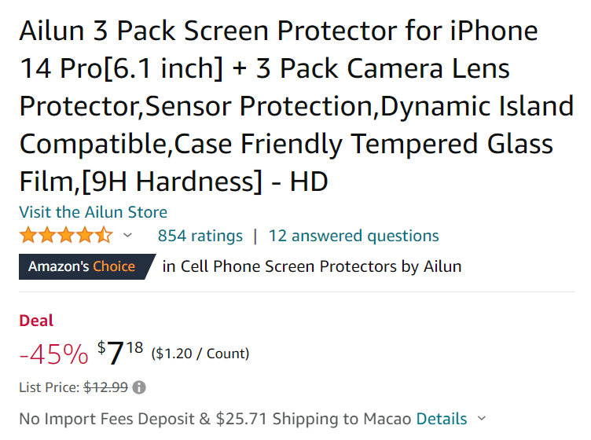

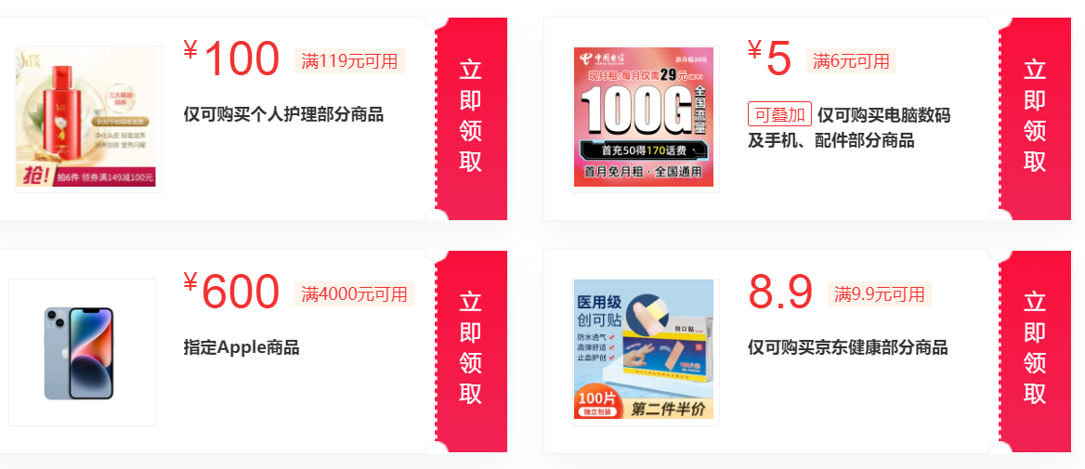
Marketing (Coupons)
Discounts on Amazon
Coupons on JD.com

Slide 13
Conclusion
User-friendly Design
Business Model
Online Shopping Mall
Marketing

Slide 14

Q & A

Slide 15
References
[1] [Online]. Available: https://www.techtarget.com/searchcio/definition/e-commerce.
[2] JD.com. [Online]. Available: https://www.jd.com/.
[3] "Amazon," [Online]. Available: https://www.amazon.com/.
[4] "Business Model of Amazon," [Online]. Available: https://fourweekmba.com/amazon-business-model/.
[5] "Comparsison of Business Models," [Online]. Available: https://medium.com/@a.ruzainirashid/alibaba-vs-amazon-how-does-their-business-models-differ-f0aa66364c60.

